Slide 1
Heart disease Prediction
Report

Slide 2
Intoduction/Objective
The objective of this project is to develop a machine learning model that can effectively predict the presence or absence of heart disease based on various medical and lifestyle factors.
The details given to understand the impact on heart include cholesterol level, blood pressure, alcohol consumption, weight, age, and etc.
Data used in this model is cardio_data.csv

Slide 3

Stapes taken to create the model
Importing tools such as pandas
Uploading data
Understanding data and data types
Data clearning(Changing types, droping uneccesary columns, replacing measing values, removing dublicates and etc.
Inspecting and Handling Outliers
Scaling/Normalizing standard scale
Interpreting Correlation Matrix

Slide 4
Machine learning Models created
Mean Squared Error
R^2
Logistic Regression
Random Forest
Decision Trees

Slide 5
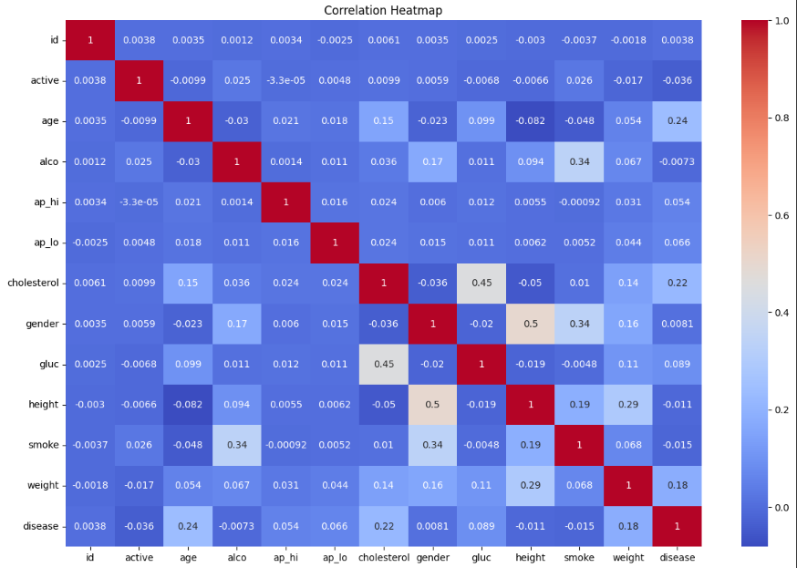
Interpretation of correlation Matrix
.
Basically here we wanted to understand the correlation between other relevet columns and our main target feature which is disease.
Take a good look at age, cholesterol, weight

Slide 6
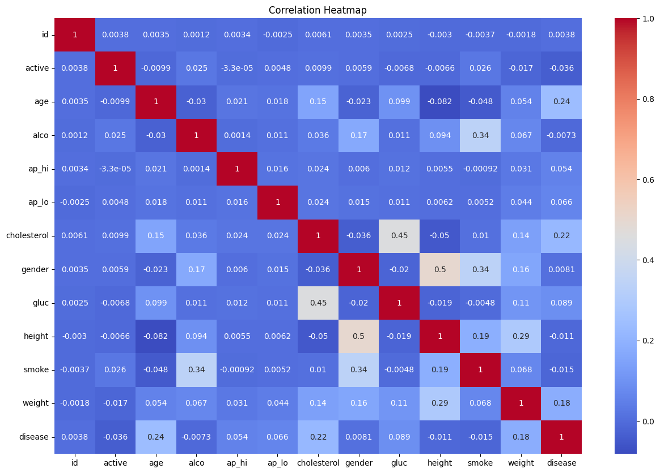
Correlatin Matrix
For simplicity let use the colour scales: The dark red values show us that there is strong positive correlation between two features. for example (ap_hi & ap_lo)
Dark Blue which are high negative values show us strong negative correlation. as one increases the other tends to decrease. For example (weight and age)
White boxes which are low absolute values that are close to zero show use weak or no correlation.
Diagonal line shows us a perfect correlation 1
When looking at our Target variable correlation we can see that columns with stronger correlation with it are Age, Cholesterol and weight meaning that an increase in any of these features has likelihood of disease presence.

Slide 7
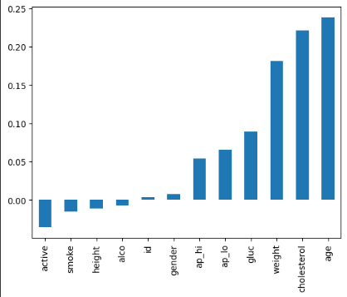
Correlation Graph
These bars represent the correlation of a feature with our target column Disease. it is sorted in ascending order with negative correlations on the left and positive ones on the right.
The bars closer to zero indicate a weak correlation with disease.
strongly correlated features are the ones that should be prioritized as they are more likely to contribute to accurate predictions

Slide 8
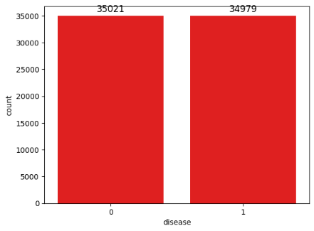
Showcasing our target variable Disease
This shows us the number of people with disease(1) and those withouth it (0)

Slide 9
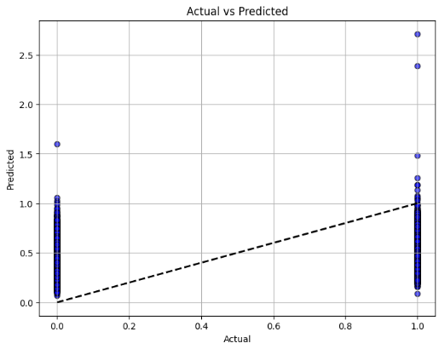
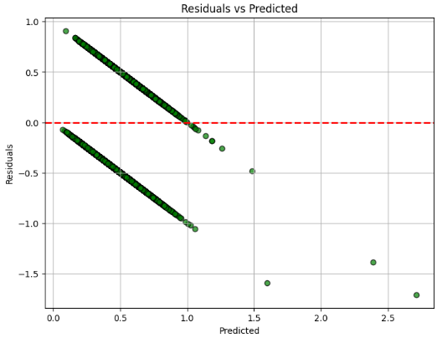
Showing our calculated Mean Squared Error & R^2

Slide 10
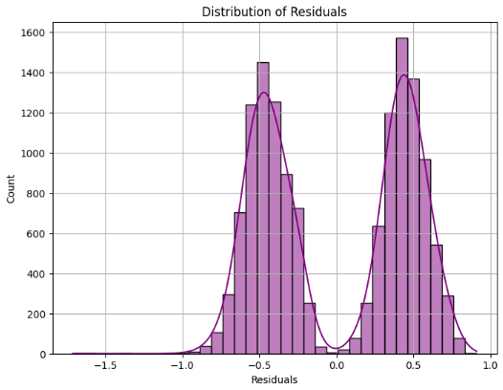
Showing our calculated Mean Squared Error & R^2
Actual vs Predicted Plot: shows us how close the model's predictions (y_pred) are to the true values (y_test). Ideally, all points should lie close to the diagonal line if the model is performing well.
Residuals Plot: shows the difference between the actual and predicted values.
Residuals Distribution: A histogram or kernel density estimate (KDE) helps us check if the residuals are normally distributed.
In linear regression, normally distributed residuals indicate a well-performing model.

Slide 11
Mean Squared Error & R^2 Conclusion
According to the results on pevious 2 pages:
The MSE of 0.23 is low meaning the model is making predictions close to the actual disease values. Suggeting that age weight, height, ap_lo and ap_hi cotain useful information for predictind disease. (less erros)
In tearms of R^2 Score of 0.1 which is close to 0 suggets that our features do not explain much of the variability in disease. (There is less explanatory power)

Slide 12
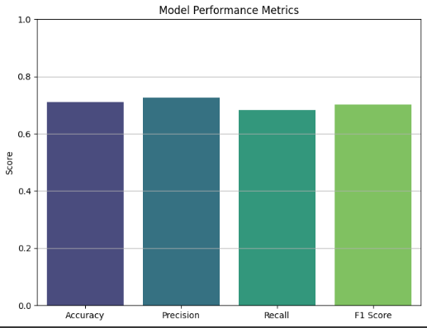

Logistic Regression

Slide 13
Logistic Regration Interpretation
Accuracy of 71.12% (measures the proportion of total correct predictions) meaning the model is correctly predicting the presence or absence of the disease.
Precision of 72.5% (proportion of true positive predictions out of all positive predictions) this tells us that when the model predicts a positive case (presence of disease), it is correct 72.5% of the time.
Recall of 68.2% the model identifies 68.2% of all actual disease cases correctly
F1 Score of 70.3% indicates a balanced performance between precision and recall.
All in all our model is moderately effective, with balanced performance across these metrics, especially given that the precision and recall are close to each other. This indicates the model isn’t heavily biased toward one type of error

Slide 14
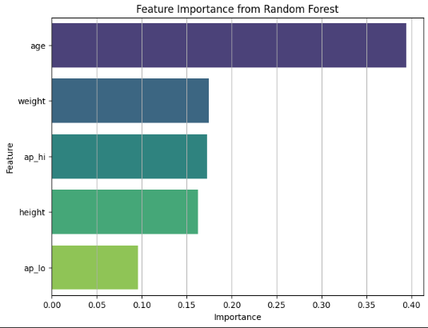
Random Forest
Age has a score of 39.4% which means it plays a significant role in determining the disease outcome and it has the largest impact on the model predictions.
Disease is closely related to age because age seems to be highly influential.
Weight has a score of 17.5% meaning it is the second most important feature.(It has moderate impact on predicting the disease).
ap_hi has a score of 17.2% this tells us that blood pressure is relevant to disease predictions.
height has a score of 16.3% meaning it also does have a notable factor even if though it is slightly less important than weight.
ap_lo is our lowest important feature as it has the lowest score of 9.6%. this means that it could have some relevance to disease but its not as strong.

Slide 15
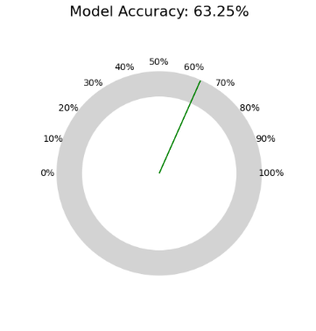
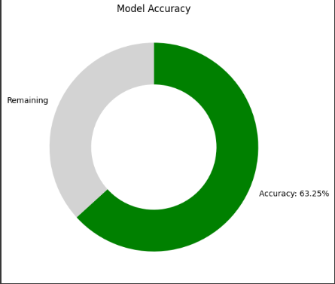
Model Evaluation

Slide 16
Model Evaluation Conclusion
The Accuracy of 63.3% means that our model correctly predicted the target outcome which is the presence/absence of the disease.
This simply means that out of all predictions 63.3% was accurate while 37% was incorrect.

Slide 17
Conclusion
Our analysis revealed that features such as age, cholesterol, and weight have the strongest correlations with heart disease, indicating that increases in these factors are more likely associated with the presence of the condition.
The model's Mean Squared Error (MSE) of 0.23 suggests that it makes predictions close to the actual values, demonstrating that features like age, weight, height, blood pressure (ap_lo, ap_hi) contain useful information for predicting heart disease, although some error remains. However, the R² score of 0.1 indicates that the model has limited explanatory power, meaning that the selected features explain only a small fraction of the variability in heart disease outcomes.
While an additional accuracy score of 63.3% suggests a moderate level of overall prediction success in another test split, these metrics, taken together, show that the model is moderately effective, with balanced performance across different measures. Although the model has room for improvement in capturing all the variability in heart disease, it provides reasonable predictive power and could serve as a helpful tool for identifying potential heart disease cases

